Slide 1
Windows IoT Core Introduction
Tomoya Yamanaka

Slide 2
What is Windows IoT Core?
Windows 10 IoT Core is a version of Windows 10 that is optimized for smaller devices with or without a display that run on both ARM and x86/x64 devices.
https://docs.microsoft.com/en-us/windows/iot-core/windows-iot-core

Slide 3
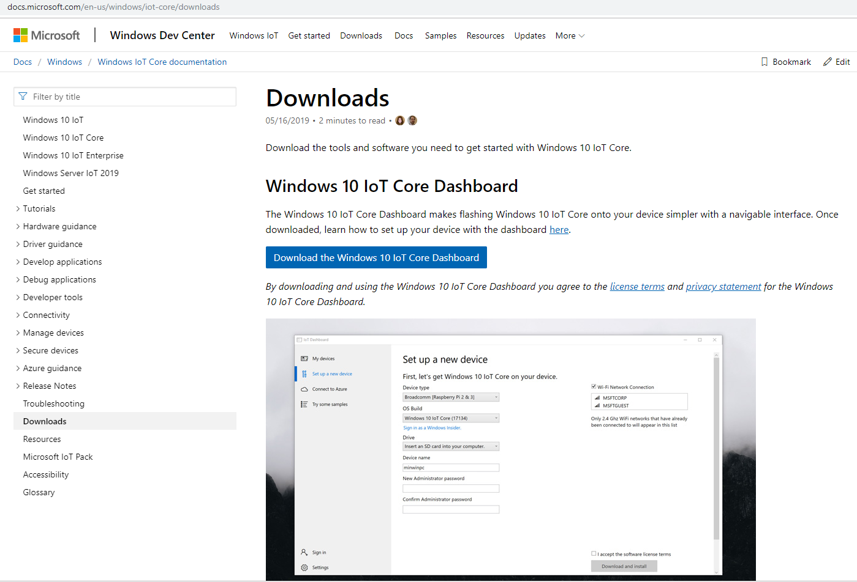
How to use?
Running Windows 10 IoT Core on Raspberry Pi 2/3 is the easiest.
You can flash the OS image through Windows 10 IoT Core Dashboard. It can be downloaded in such following URL
https://docs.microsoft.com/en-us/windows/iot-core/downloads

Slide 4
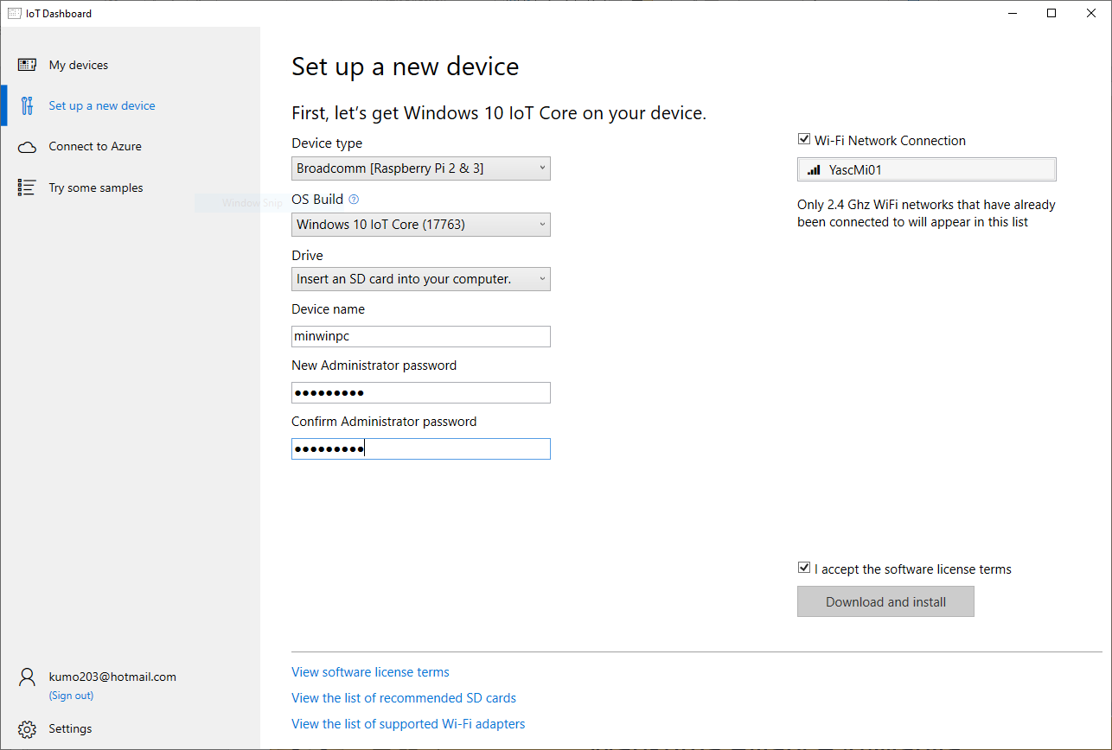
How to use?
With the Windows program, you can setup the OS image flashed micro SD card in easy!

Slide 5
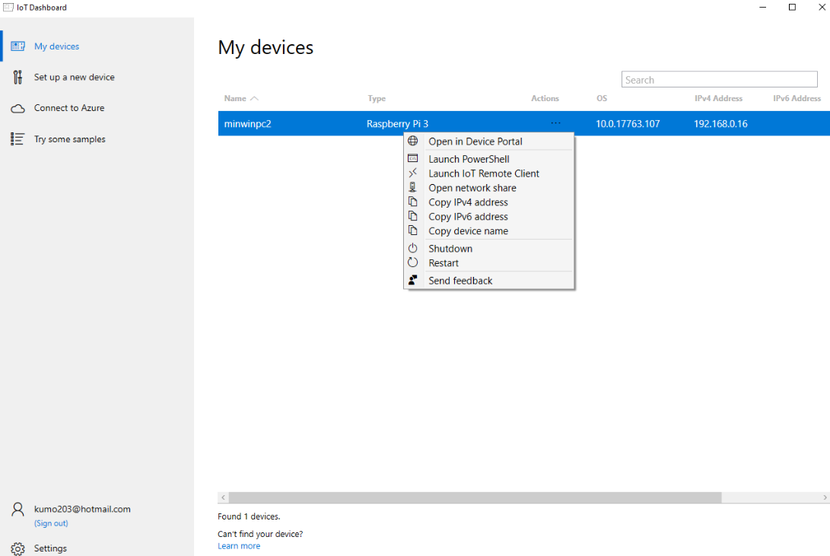
How to use?
You can handle the devices in the network with the program also.

Slide 6
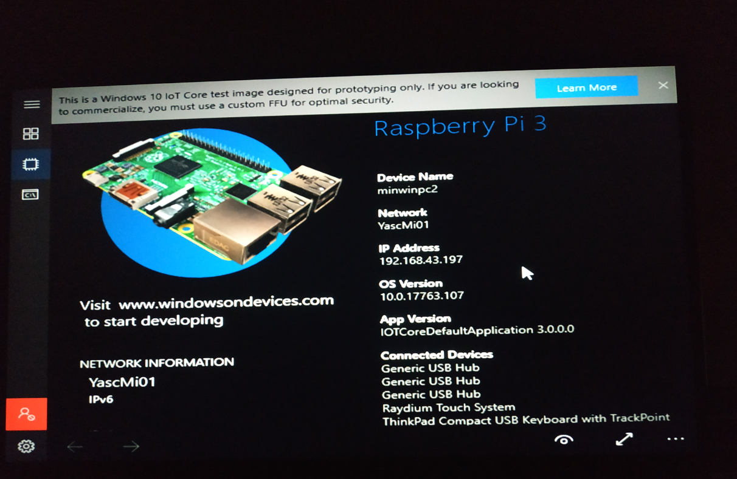
Windows IoT Core Screens

Slide 7
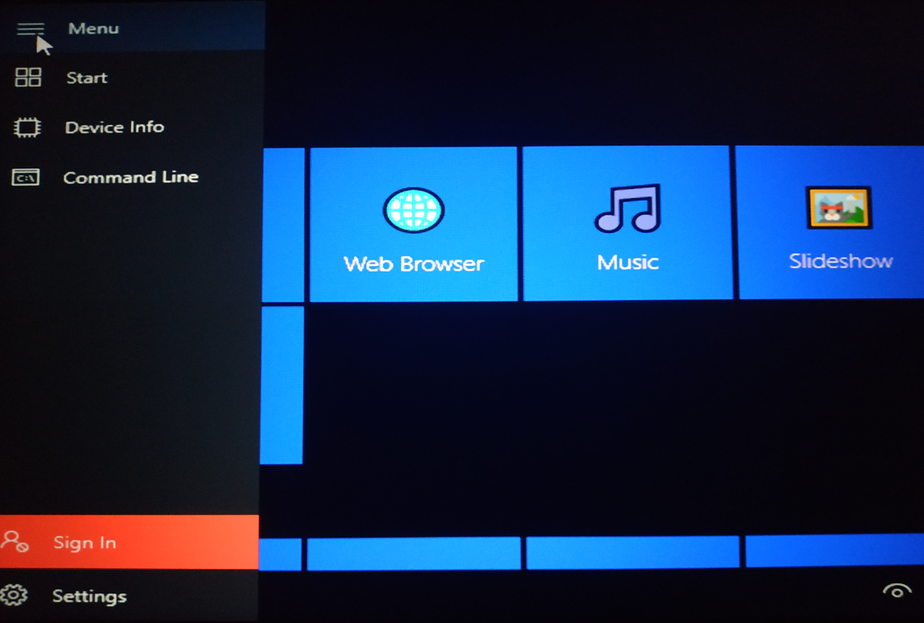
Windows IoT Core Screens

Slide 8
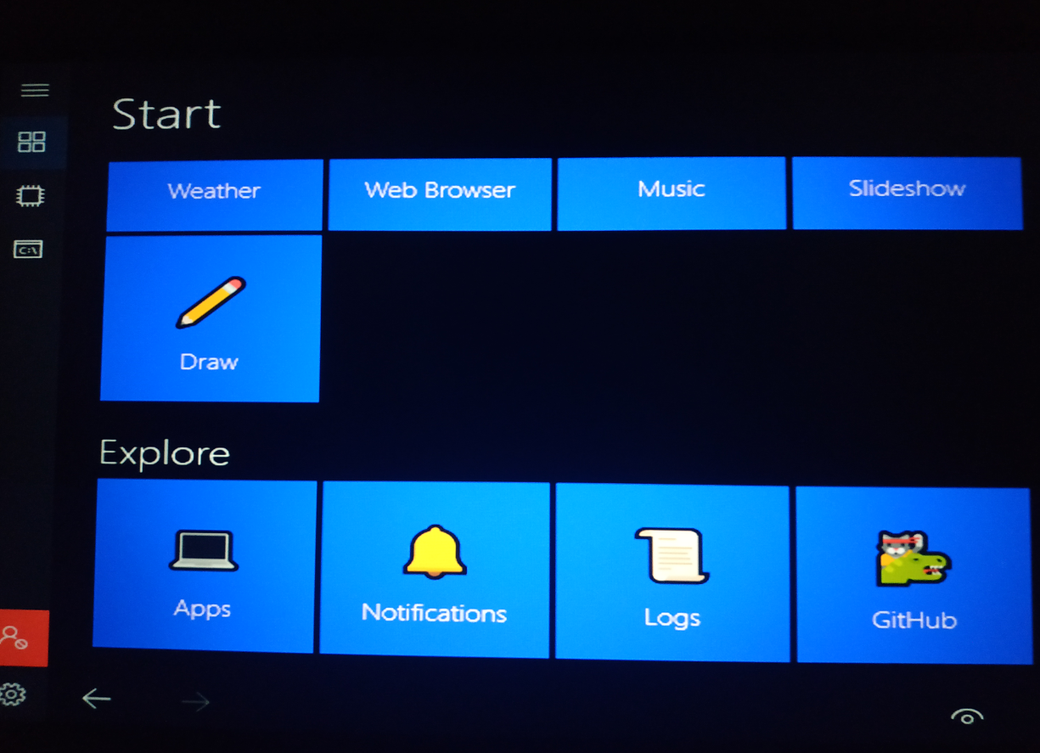
Windows IoT Core Screens

Slide 9
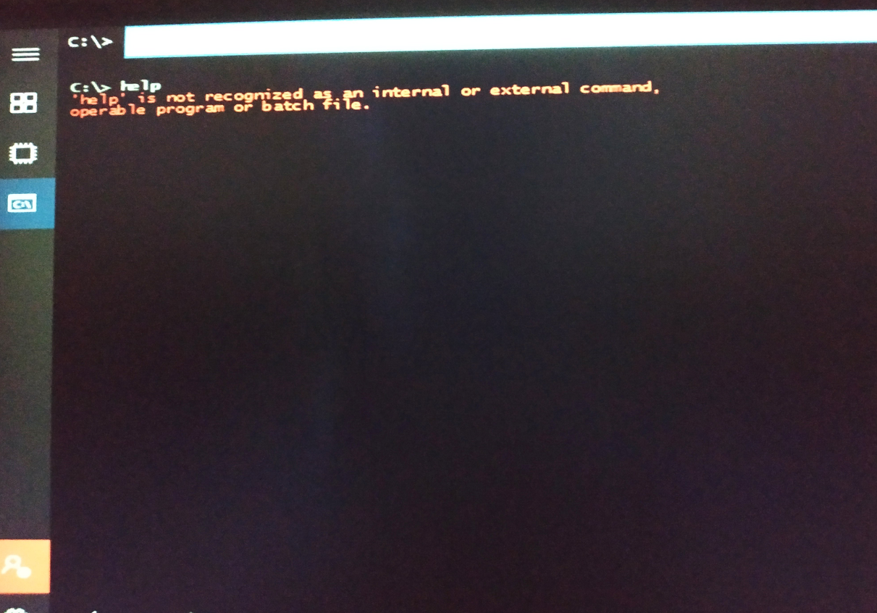
Windows IoT Core Screens

Slide 10
END

